Slide 1
The framework of the course
BASIC SKILLS OF
THE DIGITAL AGE
Competence areas covered:
Introductory competence area: Working with devices
Information and Data Literacy
Communication and Collaboration
Digital Content creation

Slide 2
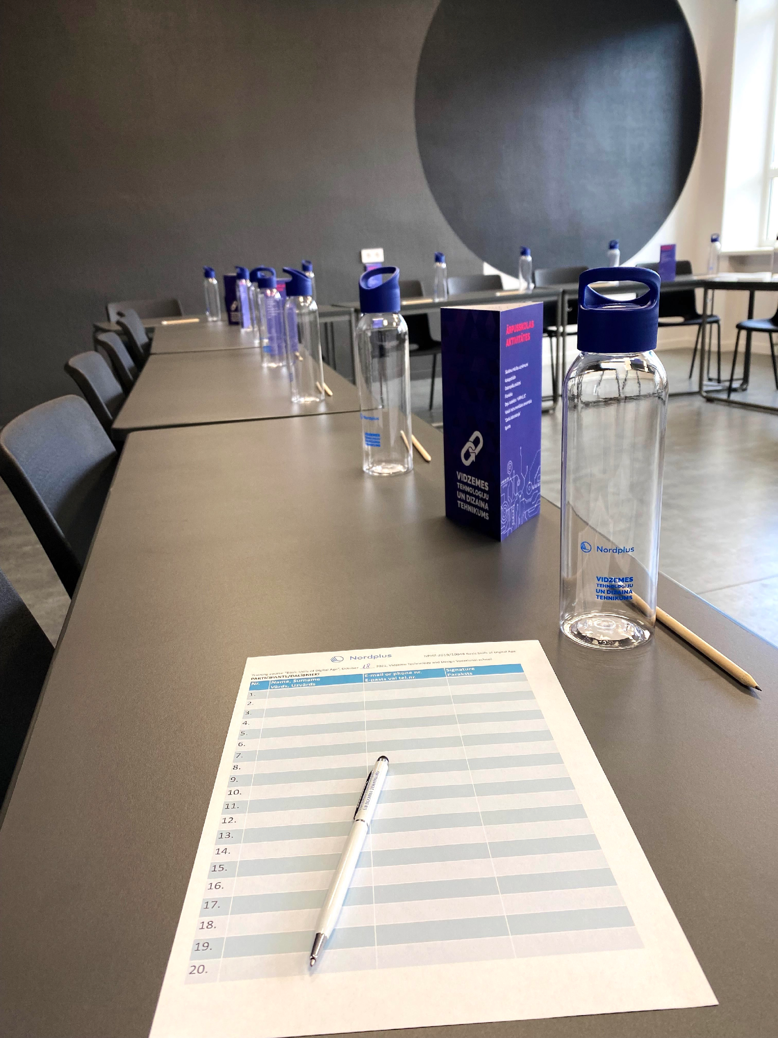
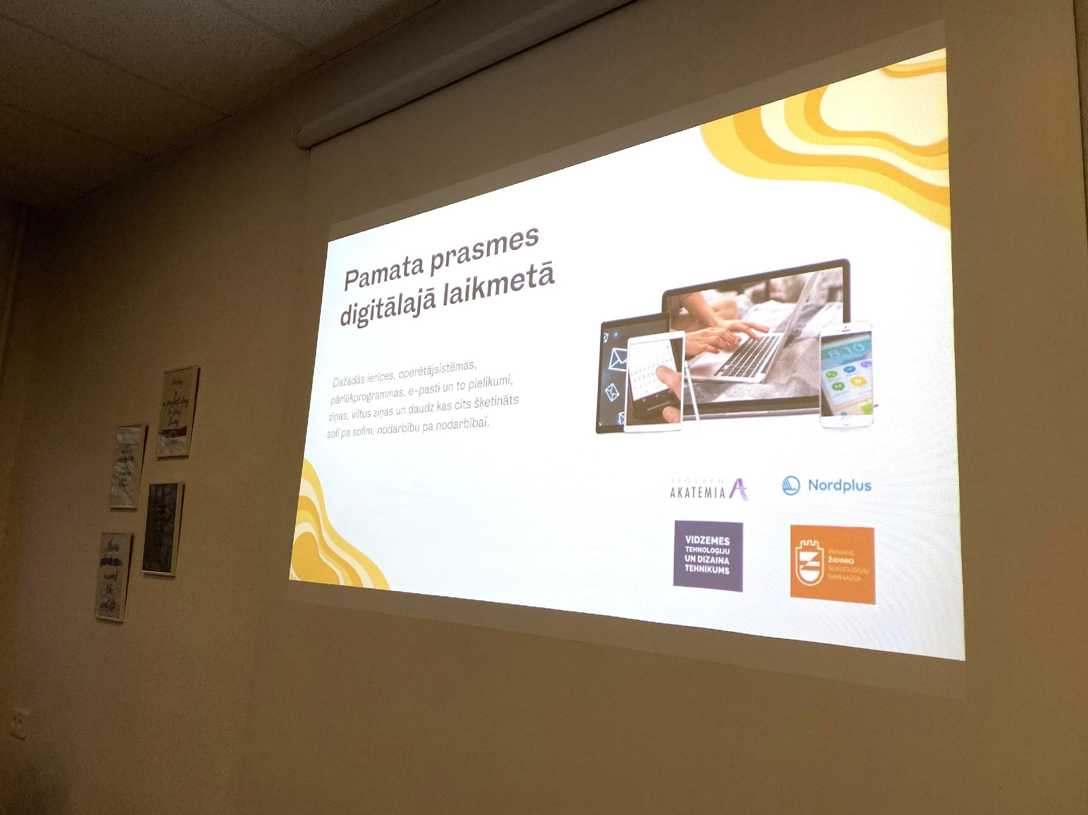
Dear adult educator!
Welcome to the framework of „Basic Skills of Digital Age” - a Nordplus project nr. NPHZ-2019/10048 developed by Workers´ Academy (Työväen Akatemia) from Finland, Vilnius Zidinio adults´ gymnasium from Lithuania and Vidzeme Technology and Design Vocational school from Latvia.
The aims of the project were to develop a modern course, Basic Skills for the Digital Age, to enhance basic digital skills for students and for adult learners to strengthen modern day citizenship skills and hence to prevent inequality to raise the awareness to the Baltic and Finnish contemporary art and culture of the educators involved.
The aim of the training course is:
- To strengthen modern day active citizenship skills of the learners and students of each partner, and hence to prevent inequality
- To give students and learners a positive learning experience
- To educate good and active citizens who have the skills and the desire to develop society for the better
Please feel free to use the course framework for your teaching activities!
Let’s have a positive learning experience together!

Slide 3
From our experience: How did we implement the „Basic Skills of Digital Age” course in Lithuania?
The framework was tested by 4 different teachers at Vilnius Židinio Gymnasium for Adults. They integrated the course modules into their own subjects: art, technology, mathematics, IT, ethics and psychology, and also aligned the curricula with the programme of Basic Digital Skills.
The participants of testings were students aged 18 y.o. and older, attending the third and the fourth grades in gymnasium. The integration of Basic Digital Skills topics into the curriculum has deepened students' digital competences, such as the ability to evaluate and select information, to use virtual services, to communicate online, to protect personal information and intellectual property in cyberspace, to use cloud technologies for information storage, etc.
The students found the programme very relevant, especially in these times when a large part of life is moving into virtual space. Most of the students in the gymnasium are adults who have the basics in using IT technologies. They are mostly familiar with social networking and use it for both self-expression and communication. They are also quite good at creating digital content (e.g. posts on social networks, videos, photos...). Despite this, however, students lack basic knowledge of how to use document creation and editing software and how to apply this knowledge to their school assignments or job search. Students also had challenges with media literacy, i.e., they did not know the principles of how to choose reliable sources and information, how to communicate properly on the internet, how to protect their own privacy and that of others.
In addition, it was particularly useful for the students to learn how to make use of governmental services in virtual space such as filing tax returns online, checking health data and make doctor's appointments online, getting actively involved in online prie-elections activities, etc. Gymnasium‘s students typically have knowledge of how to use virtual services for pleasure or entertainment, but have very little understanding of how digital technologies can help them to deal with work, household or citizenship challenges. Therefore, the modules of the Basic Digital Skills programme, which focus on the development of practical life digital skills, are both useful and necessary for adult students.
As almost all the students attending the Gymnasium have very basic skills in the use of technology, the allocated hours in the course were sufficient for them to master the material. An introductory course on how to use computers or smart devices in the Basic Digital Skills programme was not necessary for our students, but it can be successfully used with a target group that has almost no experience of using IT tools.

Slide 4
From our experience: How did we implement the „Basic Skills of Digital Age” course in Finland?
“The Basic Skills of Digital Age” framework has been integrated into immigrant education in Finland. Main educator was our IT-expert slash teacher who taught with two secondary teachers; one expert in the field of digital services and the other of job seeking. In addition, a teaching assistant was employed to help learners in a more individual way.
Participating students were mostly young adult immigrants but some were working age adults in their forties. Their studies consisted of Finnish language, societal subjects, and digital skills which they need in working life and for further studies. First, we organised very basic training on how to work with devices and then how to create digital content for the learners. Additionally, we included topic of social media and how to use different national digital service to become more active in the society. The course lasted total 10 weeks with 3 hours of teaching every week (45 min/hour). We used our own computer classroom for teaching.
Students gained more self-confidence during the training. For them the individual help was crucial to gain the basic skills of digital age. The level of the students’ digital skills varied a lot in the beginning. Some were more used to operating digital equipment than the others. The large difference in students’ skills was a challenge. That’s why we wanted to employ a teaching assistant who could help the teacher to individualize the teaching.
The pedagogical methods of the training were traditional IT teaching methods: demos and follow ups. The teacher saved the class contents in video and uploaded all the classes in Google Classroom learning platform. This made it possible for the students to get back to the topic with videos when they wanted to.
It is very important with this target group to have clear communication from the beginning about the course. It is also smart to include or integrate the course in the students’ study programme and curriculum. We advise to include students wishes of the topics in the syllabus. This way they are more engaged in participating in the class.

Slide 5
From our experience: How did we implement the „Basic Skills of Digital Age” course in Latvia?
“The Basic Skills of Digital Age” course in Latvia was delivered to 17 adults lacking basic skills in the digital world, mainly the learners, and our target audience was seniors. The course covered all topics mentioned in this framework. However, we emphasized individual issues as well. For example, learners found some specific issues important to them, and the teachers considered that when explaining the theory. A lot of practical work with learners' mobile devices and computers leads to great results.
The important thing in delivering the course was the situation with covid-19 restrictions. Many learners were left out of other social activities, so participation in the course allowed socializing and learning from each other.
In the beginning, learners showed a different level of knowledge, and through cooperation and various methods, they soon realized how important it is to interact and deal with problematic situations. It is important to explore and not be afraid of trying when working with devices or mobile phones. Also, many learners explored that this knowledge helps deal with daily challenges. For example, they used apps like maps, banking, and covid-19 related apps.
It is a great opportunity that this project and training course revealed adult education needs in our region. Based on that, we developed other projects related to mobility opportunities for adult educators.
It is important to implement ideas and topics related to our digital age in future teaching activities, learning syllabus, and other projects.

Slide 6
Introductory competence area – Working with devices (14 hours)
Competences | Skills and Knowledge | Topics | Module comments and ideas
1. Working with different operating systems and mobile devices | 1.1. Identifies and uses different settings and features of a mobile device | Different operating systems (OS): Android, IOs Adjusting mobile device settings: basic settings, phone book, simple call - hold, speaker, volume, change language and keyboards, wireless connections. Data storage - cloud systems, camera and functions SMS sending: text typing, auto-reply messages | Using devices (12 hours)
 | 1.2. Identifies and uses different tools of a mobile device | - Apps on mobile devices (searching for the right app, evaluating app quality, installing, uninstalling)
2. Working in different operating systems and devices, PC | 2.1. Understands desktop principles and adjusts the main operating system (OS) settings and use built-in help features | - File Explorer: structure, copy, cut, paste, search (size, date, shortcuts, etc.) - Files & folders: create, rename, delete, copy - Processes and items: sleep/shut down/hibernate, start menu, task bar - OS settings: personalize desktop settings, change language and keyboards, mouse features (one/double click)
 | 2.2. Uses keyboard keys to improve the process | - Use keyboard keys: windows key, ctrl key, alt, shift, insert, del, backspace, enter, App search (windows key)
 | 2.3. Compares different data storages and chooses the appropriate | - Data storage types: internal - HD, SSD, external data storages - memory stick, drive, other cloud based services
3. Working with browser | 3.1. Uses browser and manages browser settings, bookmarks, and web outputs | - Browser settings: tabs, account, synchronization, history,favorites, starred, bookmarks, incognito, inprivate, tab save, website types | Working with browser (2 hours)

Slide 7
Competence area: 1. Information and data literacy (12 hours)
Competences | Skills and Knowledge | Topics | Module comments and ideas
1.Browsing, searching and filtering data, information and digital content | 1.1. Defines personal information needs and aims | - Various needs (academic, official, peer-to-peer, leisure, cultural, etc.). Defining the need | Finding data effectively (8 hours)
 | 1.2. Knows the variety of search engines and their features | - Search with images, voice and text, voice input, keywords, search result interpretation, translation to and from various languages options (with camera, voice etc.)
 | 1.3. Chooses keywords for searching information | - Keywords, most popular keyword categories, SE principles
2. Evaluating data, information and digital content | 2.1. Uses different informational channels (media, social networks, etc.) | - Website types: blogs, e-commerce
 | 2.2. Uses legal data and channels | - Security, trusted sites (HTTPS)
 | 2.3. Knows the basic criteria to evaluate information | - Determination of trusted and untrusted sources, keywords
 | 2.4. Evaluates the authenticity of resources | Determination of trusted and untrusted sources, keywords Double checking information from more sources, critical thinking
3. Managing data, information and digital contents | 3.1. Systemizing and organizing gathered information | - Search with images, voice and text, voice input, keywords, search result interpretation, translation to and from various languages options (with camera, voice etc.) | Data publishing and obtaining sources, data organization (4 hours)
 | 3.2. Knows how to store and retrieve data online | - Social media: Facebook, WhatsApp, data sharing, cloud storage, Eurostat
 | 3.3. Organizes data according to the topic | - Website types, blogs, e-commerce

Slide 8
Competence area: 2. Communication and collaboration (14 hours)
Competences | Skills and Knowledge | Topics | Module comments and ideas
1. Interacting through digital technologies | 1.1. Selects simple digital technologies to interact with | - Variety of equipment: aims, basic functions, differences (PC, phone, pad, E-mail clients vs browser email) | Basic ways of communicating and collaborating online (4 hours)
 | 1.2. Identifies appropriate simple communication means for a given context | - Chat, video call tools, Google Meet, Hangout, Skype. Aims and basic functions
 | 1.3. Performs well-defined and routine interactions with digital technologies
2.Sharing through digital technologies | 2.1. Recognizes simple appropriate digital technologies to share data, information and digital content | - Tools for sharing information: E-mail (Gmail, yahoo, inbox). A new letter, contacts, attachments, signatures. - Google Drive: share file, share folder. Dropbox, Wetransfer etc.
 | 2.2. Selects well-defined and routine appropriate digital technologies to share data, information and digital content
 | 2.3. Explains how to act as an intermediary for sharing information and content through well-defined and routine digital technologies
3.Collaborating through digital technologies | 3.1.Chooses simple digital tools and technologies for collaborative processes | - Tools for collaborative processes: Google Docs (create, shere, edit)

Slide 9
Competence area: 2. Communication and collaboration (14 hours)
Competences | Skills and Knowledge | Topics | Module comments and ideas
4.Engaging in citizenship through digital technologies | 4.1. Identifies and selects simple digital services in order to participate in society | - National public digital services: aims and basic functions - E-banking services, e-shop, travel planning and social networks as an empowerment | Digital services for active citizenship (6 hours)
 | 4.2. Recognizes and indicates simple digital technologies to empower him/herself and to participate in society as a citizen | - Tools: Facebook, Twitter, LinkedIn, Instagram, etc. - Tools for implementing citizen‘s rights (e.g. rinkejopuslapis.lt – elector‘s site)
5.Netiquette | 5.1. Differentiates and clarifies well-defined and routine behavioral norms and know-how while using digital technologies and interacting in digital environments | - Basic rules of communicating online - Basic copyright issues and rules (verbal, visual, audio information) - Cultural and generational diversity issues in digital environments | Safe communication and identity management online (4hours)
 | 5.2. Chooses and expresses well-defined and routine communication strategies adapted to an audience
 | 5.3. Differentiates and describes well-defined and routine cultural and generational diversity aspects to consider in digital environments
6.Managing Digital identity | 6.1. Describes and explains well-defined and routine ways to protect his/her reputation online | - Rules of personal reputation protection online
 | 6.2. Recognizes and describes well-defined data he/she produces through digital tools, environments or services

Slide 10
Competence area: 3. Digital content creation (14 hours)
Competences | Skills and Knowledge | Topics | Module comments and ideas
1. Developing digital content | 1.1. Recognizes different programs for writing documents and their restrictions | Word, Google doc. (shared documents), Wordpad or Notepad. How to create, save, edit and re-open. Fonts, colors, margins, page sizes, headers and footers, page numbers How to import content ex. pictures - Online solutions. Which to choose? Saving locally or to shared service ex. cloud, memory stick, local network, Google docs, blogs | Creating content (12 hours)
 | 1.2. Selects various document types for different aims of usage | Saving to different formats for ex. PDF, jpg, png (how and why to do that) Using predefined layout or designing new. Business letter standard layout How to create application using business letter How to create a CV
2. Integrating and re-elaborating digital content | 2.1. Recognize appropriate tools for editing and improving different kind of documents | Editing pictures: changing size, cropping, changing resolution. Introduction to canva.com, AdobeSpark or other apps. Editing shared content in different platforms: pros and cons | Editing Content (2 hours)
3. Copyright and licenses | 3.1. Identifies rules of copyright and licences that apply to digital content | Royalty-free pictures and image banks Photographing people

Slide 11
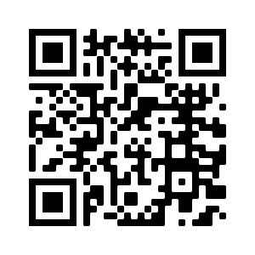
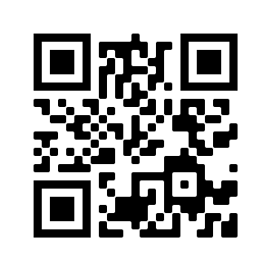
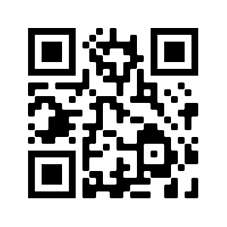
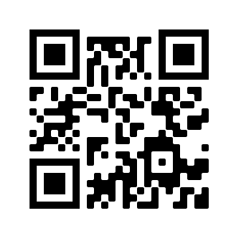
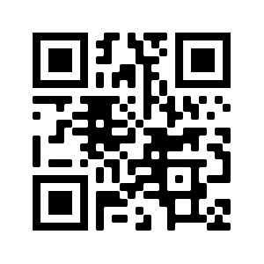
We wish you a successful teaching with our course!
Feel free to use videos made for the course purposes:
Tutorial: Canva https://youtu.be/xbGYeYaAe70
Tutorial: Gmail account https://youtu.be/-onVKLetBjQ
Tutorial: Google document https://youtu.be/vBOB6W1SkT8
Tutorial: Sending an e-mail https://youtu.be/A7G7G8uoX5U
Tutorial: Gmail attachment https://youtu.be/ULVl7v0rfKA

